Slide 1
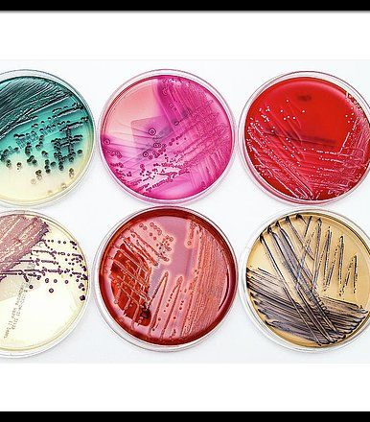
Media as a part of the identification approach
BT233 – General Microbiology Laboratory

Slide 2
Bacteria –as the other living organisms- need energy, vitamins, minerals, proteins, co-factors, and growth factors in order to grow
All these substances can be provided to bacteria through media
Media: the source of energy, vitamins, minerals, proteins, co-factors, water, and growth factors
“It is used to cultivate bacteria by supporting their growth”

Slide 3
• All types of media have main characteristics, these are:
1. Must be sterile prior the inoculation
2. Must provide bacteria with nutrients in the form of a carbon source, vitamins, growth factors, proteins, minerals, and water

Slide 4
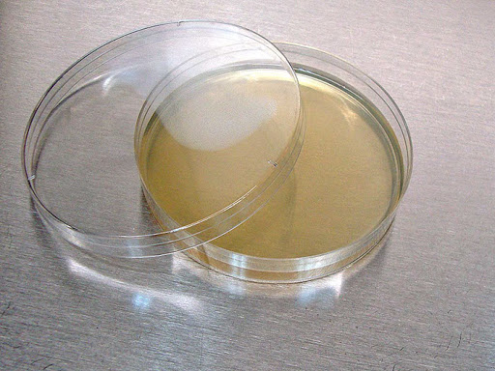
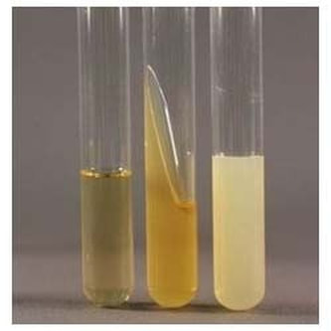
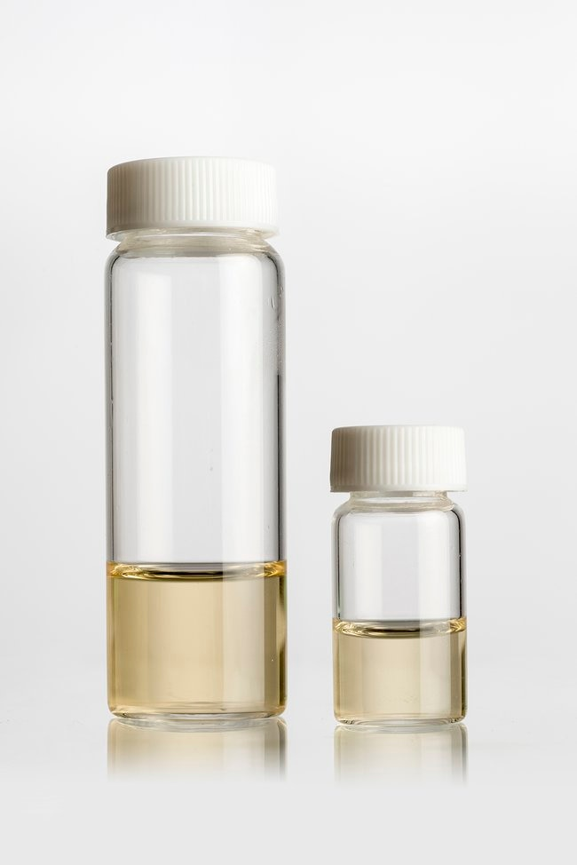
Media can be classified according to the percentage of agar (solidifying agent) into different status:
Solid media:
- contains ≥ 1% agar
- e.g.: Nutrient agar, MacConkey, Bismuth media
Semisolid media:
- contains ≤ 1% agar
- e.g.: sulfide indole motility (SIM)
Liquid media (Broth):
- contains No agar
- e.g.: Nutrient broth, Lactose broth, thioglycolate media

Slide 5
Media can be classified according to shape into different groups:
Media takes the shape of the vessel that it is being poured into
Plate (solid)
Slant (solid)
Stab (solid or semisolid)
Vial (liquid)

Slide 6
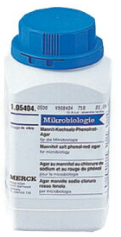
Media can be classified according to the composition into different groups:
Simple (defined) media: is synthetic and has defined components and ratio of components
This type media can be synthesized from its raw materials
Complex media: is non-synthetic and undefined in either its components, ratio of components or both. E.g.: meat media, brain heart infusion agar

Slide 7
The main components of Media X are:
Lactose: 5.0 g
Sucrose: 3.0 g
Xylose: 2.5 g
Peptone: 4.3 g
Agar: 12 g
You can mix all of these components with 1L of water and synthesize the media
Simple (defined) media

Slide 8
Media can be classified according to the purpose into different groups:
1. General media:
Purpose: allow the growth of all non-fastidious bacteria
e.g.: nutrient agar, nutrient broth, standard plate count agar
2. Enrichment media:
- Purpose: allow the growth of all bacteria, including fastidious ones, but only some types will grow more than the others
e.g.: Lactose broth allows Salmonella typhi to flourish
Salmonella typhi is found on chicken skin, and if we inoculate the bacteria found on a chicken skin, S. typhi will grow the best

Slide 9
3. Selective media:
- Purpose: allow the growth of only one type of bacteria and suppress the growth of all others
e.g.: Pseudomonas F agar (selects for Pseudomonas aeruginosa), Chocolate agar (selects for Neisseria), Mannitol salt agar (selects for Staphylococcus), King B (selects for Pseudomonas)
4. Differential media:
- Purpose: to distinguish which species possesses and which species lacks a particular biochemical/metabolic pathway ( differentiate types of bacteria according to the colors of the colonies or the color of the media)
- e.g.: - General Differential media: nutrient agar (differentiates between some Pseudomonas species and other types of bacteria)
- Selective differential media: EMB, MacConkey
- Enriched differential media: Blood agar

Slide 10
The types of media that will be discussed in this lab are:
Nutrient agar
Blood agar
3. MacConkey agar (MAC)
Eosin Methylene Blue (EMB)
Xylose Lysine Deoxycholate (XLD)
Mannitol Salt Agar MSA

Slide 11
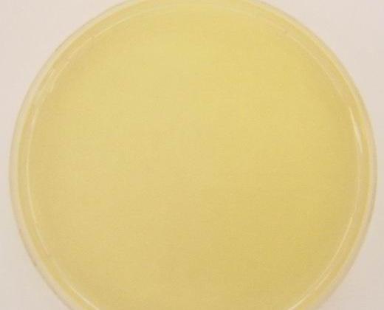
Nutrient agar
Type: General differential media
Purpose: to allow all non-fastidious bacteria to grow

Slide 12
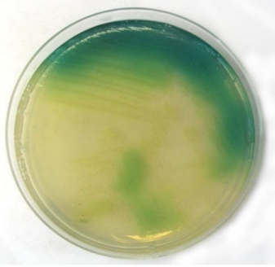
If bacterial colonies turn the media around it to green, then the bacteria is either Pseudomonas syringae or Pseudomonas aeruginosa and the pigment is pyocyanin.
To differentiate between them, we must consider the source:
- P. aeruginosa: from clinical (human) samples
- P. syringae: from plant samples

Slide 13
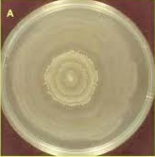
• If there is swarming (concentric circles) on the media, then the bacteria is a species of Proteus.
If the bacteria is from a clinical sample, then it is Proteus vulgaris.

Slide 14
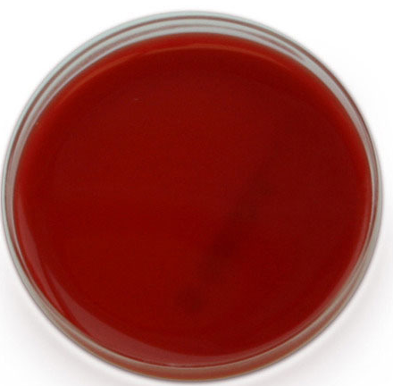
Blood agar
Type: Enriched differential media
Purpose: to distinguish which species possesses and which species lacks a particular biochemical/metabolic pathway while also allowing fastidious bacteria to grow
(Differentiate the types of bacteria that have the ability to hemolyze blood

Slide 15
Blood agar consists of nutrient agar and 7% blood
- If human pathogen, use human blood
- If animal pathogen, use sheep blood
blood agar is prepared by boiling nutrient agar then autoclaving it at 121°C and 15 psi for 15 minutes, then wait for the molten nutrient agar to cool to holding temperature (45°C) and add 7% blood
If we do not wait for the molten agar to cool and instead add the 7% blood at high temperatures, we will get chocolate media instead of blood agar

Slide 16
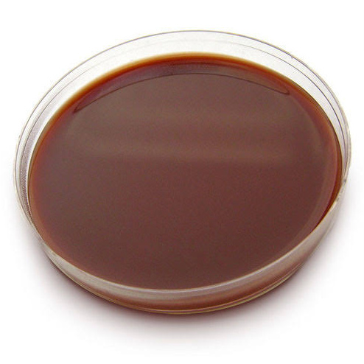
Blood media
Chocolate media

Slide 17
If the bacteria causes the blood to disappear/turn yellowish, then β-hemolysis has occurred and the blood has been completely hemolyzed.
This means that the bacteria secretes the enzyme hemolysin
e.g.: Klebsiella
If the bacteria causes the blood to turn green, then α-hemolysis has occurred and the blood has been incompletely hemolyzed.
e.g.: E. coli
If the bacteria causes the blood to remain unchanged, then γ-hemolysis has occurred and the blood has not been hemolyzed at all
e.g.: Staphylococcus epidermidis

Slide 18
Type of hemolysis | Changing in media color | Blood hemolysis | Example
α-hemolysis | the blood to turn green | incompletely hemolysis | E. coli
β-hemolysis | blood to disappear/turn yellowish | completely hemolysis | Klebsiella
γ-hemolysis | unchanged | No hemolysis | Staphylococcus epidermidis

Slide 19
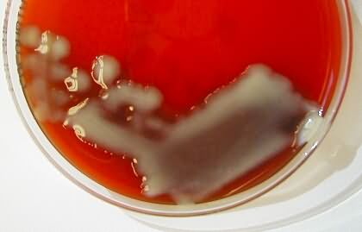
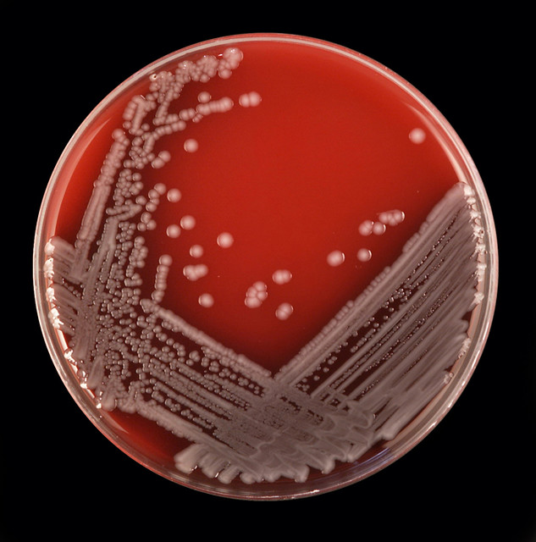
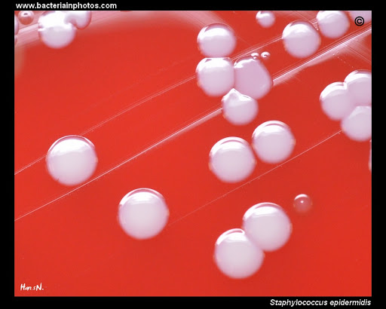
Klebsiella on Blood media
E. coli on Blood media
S. epidermidis on Blood media

Slide 20
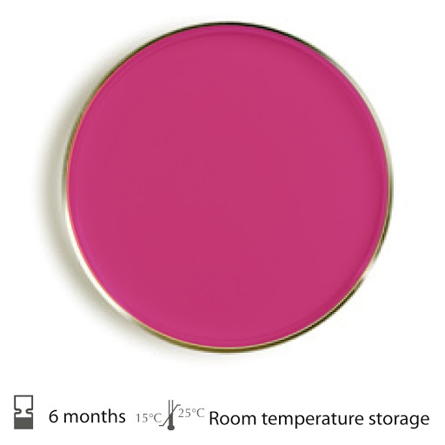
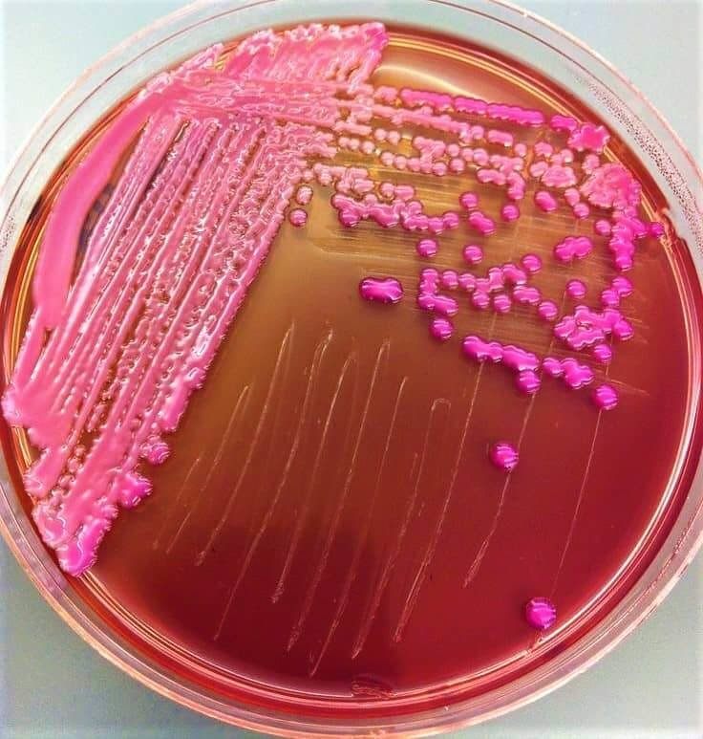
MacConkey agar
Type: Selective differential media
Purpose: to selectively isolate G- bacteria and differentiate them based on lactose fermentation
(Differentiate Klebsiella from other types of Gram –ve bacteria)
Klebsiella grow on MacConkey agar as:
pink mucoid glistening colonies

Slide 21
MacConkey agar consists of the following components:
1. Bile salt: inhibits G+ bacteria except Enterococcus and Staphylococcus
2. Crystal violet: inhibits Enterococcus and Staphylococcus
3. Lactose: carbon source
4. Peptone: amino acid and protein source
5. Neutral red: a pH indicator that is:
pink under acidic conditions
Red under neutral conditions
Yellow under alkaline conditions

Slide 22
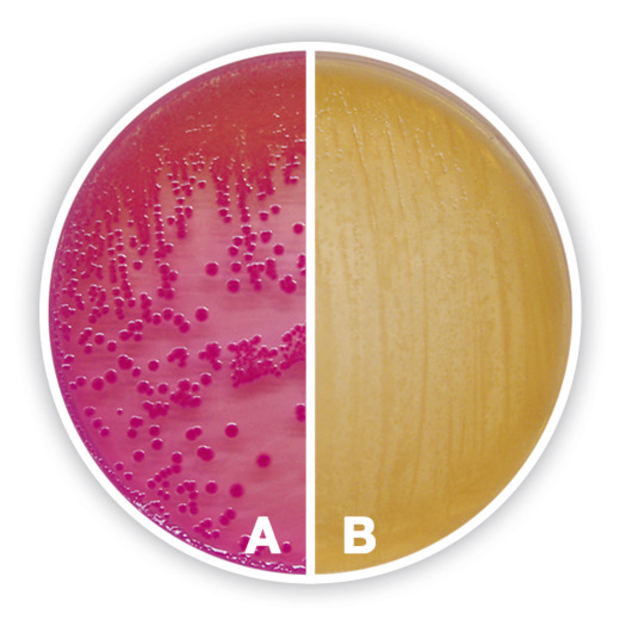
If a bacteria can ferment lactose, it will produce acid metabolites. If a bacteria cannot ferment lactose, it might degrade the lactose to produce alkaline metabolites
If the bacteria is a lactose fermenter, then the media will turn pink (A)
If the bacteria is a non-lactose fermenter, then the media will either remain red or turn yellow (B)

Slide 23
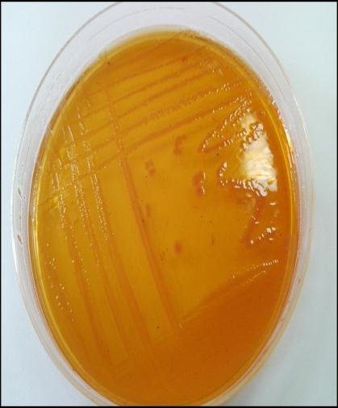
Klebsiella on MacConkey media
S.typhi on MacConkey media

Slide 24
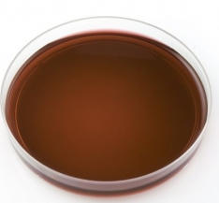
Eosin Methylene Blue (EMB)
Type: Selective differential media
Purpose: to selectively isolate G -ve bacteria and differentiate between coliform bacteria
(Differentiate E.coli from other lactose fermenter bacteria)

Slide 25
EMB consists of the following components:
1. Eosin and methylene blue: inhibits G+ bacteria and react with acid from lactose fermentation to form a colored precipitate
2. Lactose: carbon source

Slide 26
The color of the precipitate depends on the amount of the precipitate, and the amount of the precipitate depends on the amount of acid produced
- If the amount of acid is high: the color is green metallic sheen
If the amount of acid is low: the color is pink
• If the colonies are colored on EMB, it means that the bacteria is lactose fermenter
• If the colonies are colorless on EMB, it means that the bacteria is non-lactose fermenter
Colored colonies lactose fermenter
Colorless colonies non-lactose fermenter

Slide 27
Small green metallic sheens on EMB are E. Coli
Pink/buff colored colonies are Enterobacter aerogenes
Colorless colonies could be Proteus, Salmonella, Shigella, Pseudomonas

Slide 28
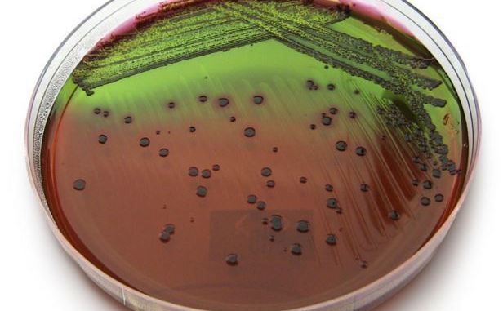
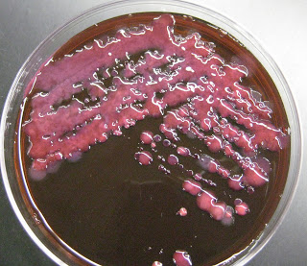
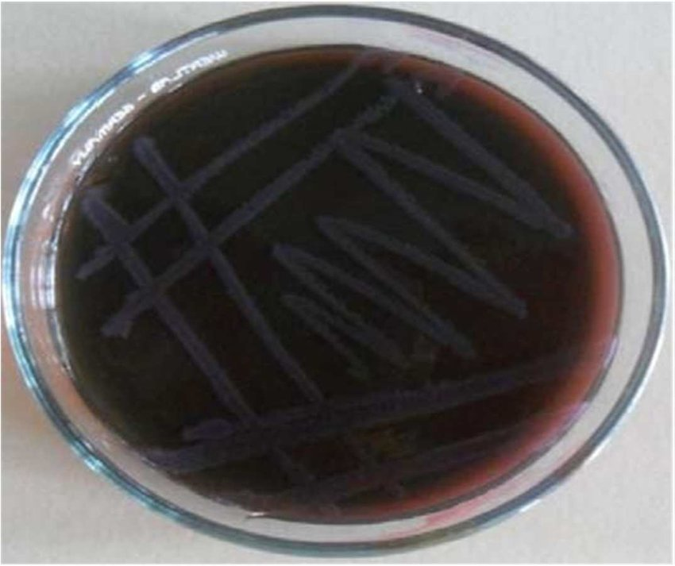
E.coli on EMB media
Enterobacter aerogenes on EMB media
Salmonella aerogenes on EMB media (Grey)

Slide 29
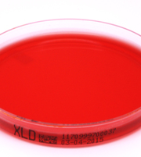
Xylose Lysine Deoxycholate (XLD)
Type: Selective differential media
Purpose: to selectively isolate Salmonella and Shigella species from clinical samples and from food
differentiate between Salmonella and Shigella species based on xylose fermentation and L-lysine decarboxylation

Slide 30
XLD consists of the following components:
- Yeast extract: to support bacterial growth
- Xylose: 1st carbon source
- Sucrose: 2nd carbon source
- Lactose: 3rd carbon source
- L-lysine: 4th carbon source
- Sodium deoxycholate: inhibits G+ bacteria
- Sodium thiosulfate: sulfur source
- Ferric ammonium citrate: sulfate indicator that reacts with sulfur to form ferric sulfate (black ppt)
- Phenol red: a pH indicator:
Yellow under acidic conditions
Red under neutral conditions
Pink under alkaline conditions

Slide 31
Xylose is fermented by Salmonella but not Shigella (phenol red turns from red (neutral) to yellow (acidic)), so:
Shigella colonies will remain red
Salmonella colonies will turn yellow
L-lysine differentiates Salmonella from pathogenic species:
- when xylose is depleted, Salmonella decarboxylates L-lysine and produces ammonia (phenol red turns from yellow (acidic) to red (neutral)
This will mimic Shigella >> To prevent similar reversion, the incubation time should not be too long

Slide 32
But if the bacterial culture was incubated too long, and the colonies appeared in red color, Salmonella can be distinguished from Shigella by:
- Salmonella can metabolize thiosulfate to produce hydrogen sulfide (H2S), which reacts with ferric ammonium citrate to produce black ferric sulfate at the center of their colonies
- Shigella cannot metabolize thiosulfate, so they will not have any dark centers

Slide 33
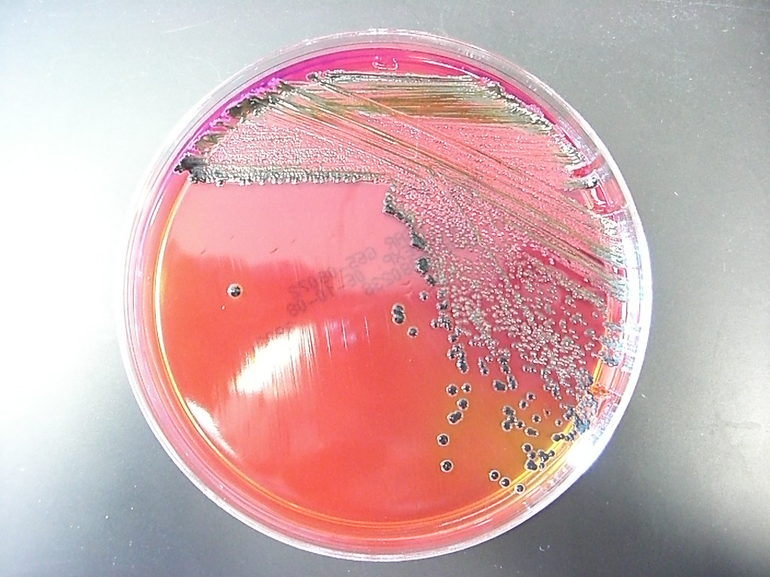
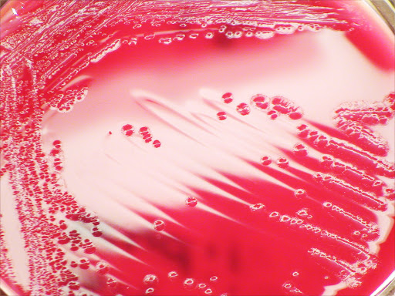
Salmonella on XLD media
Shigella on XLD media

Slide 34
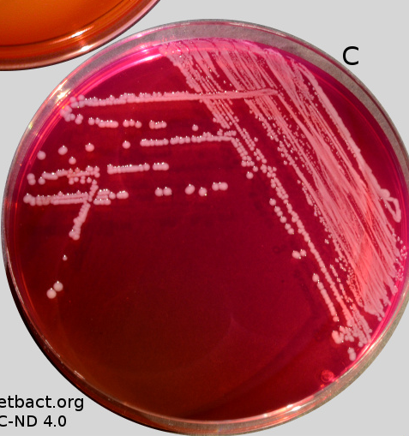
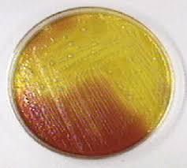
P. aeruginosa on XLD (Pink flat rough)
E. coli on XLD media (yellow)

Slide 35
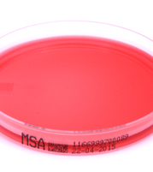
Mannitol salt agar (MSA)
Type: Selective differential media
Purpose: to select for G +ve bacteria such as Staphylococcus and Micrococcaceae and differentiate them based on mannitol fermentation

Slide 36
MSA consists of the following components:
- 7.5% NaCl: high salt concentration allows only halophilic and G +ve bacteria to grow
- Mannitol (alcohol of mannose): carbon source
- Phenol red: a pH indicator:
Yellow under acidic conditions
Red under neutral conditions
Pink under alkaline conditions

Slide 37
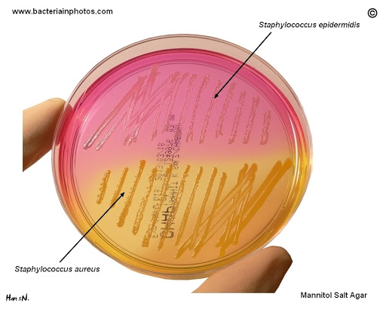
If bacteria cannot grow on MSA, then it is nonhalophilic
If bacteria can grow and changes the media to yellow, then it is a halophilic mannitol fermenter
e.g: (Staphylococcus aureus)
If bacteria can grow but the media is unchanged, then it is a halophilic non-mannitol fermenter
e.g: (Staphylococcus epidermidis)

Slide 38
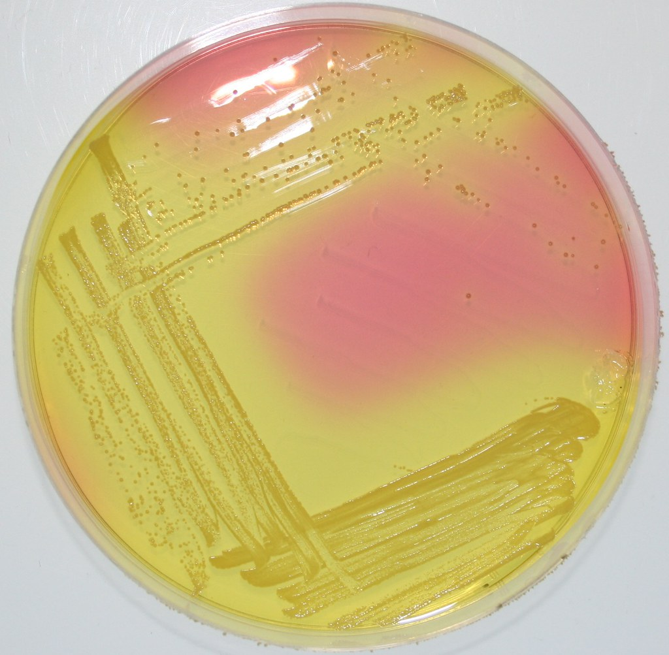
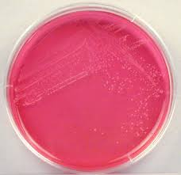
Staphylococcus aureus on MSA
Staphylococcus epidermidis on MSA

Slide 39
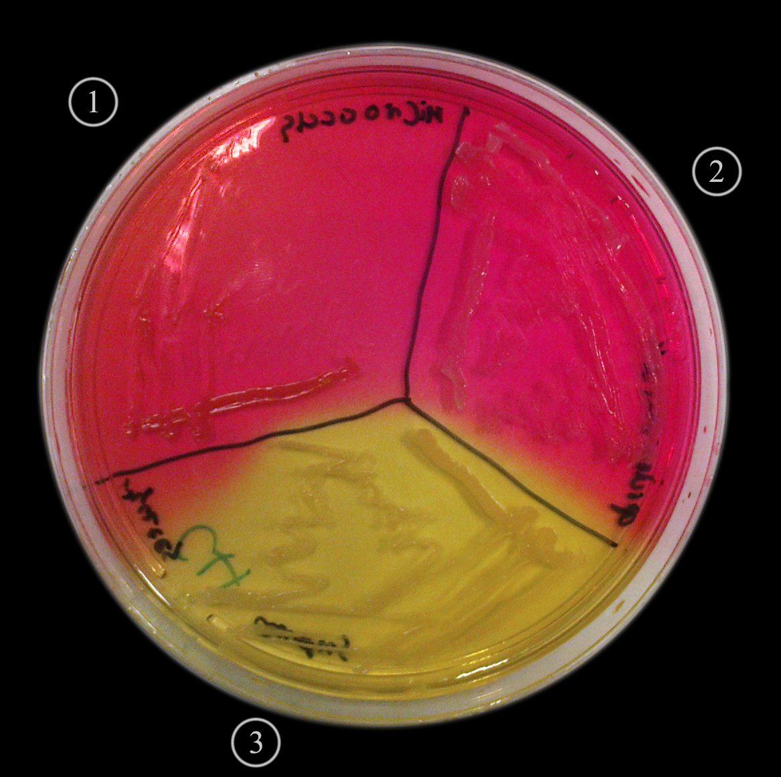
Practical part:
You will divide the agar plate into three parts by drawing the Mercedes sign on it. Then, you will inoculate different types of bacteria on each part by using a sterile inoculating loop

Slide 40
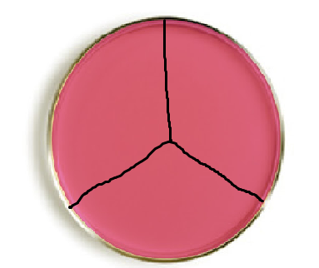
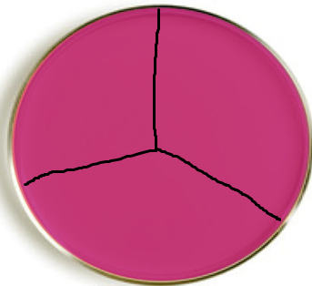
1. To isolate Gram negative Bacteria
Klebsilla
Staph
E.coli
Staph
Salmonella
Salmonella
MSA
MacConkey
2. To isolate Gram positive Bacteria

Slide 41
Expected Results for Different Media

Slide 42
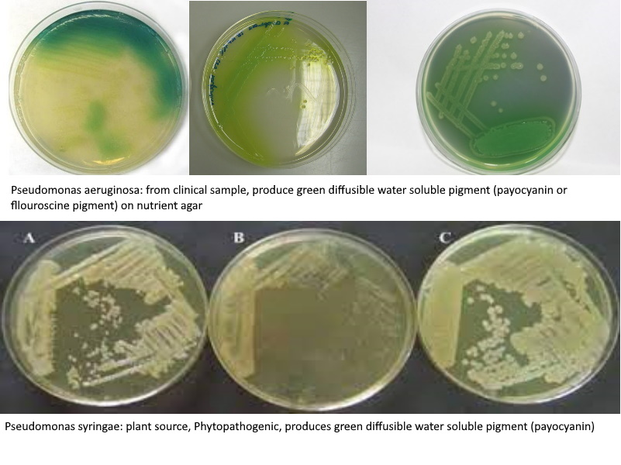
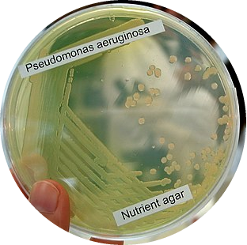
Results Nutrient Agar

Slide 43
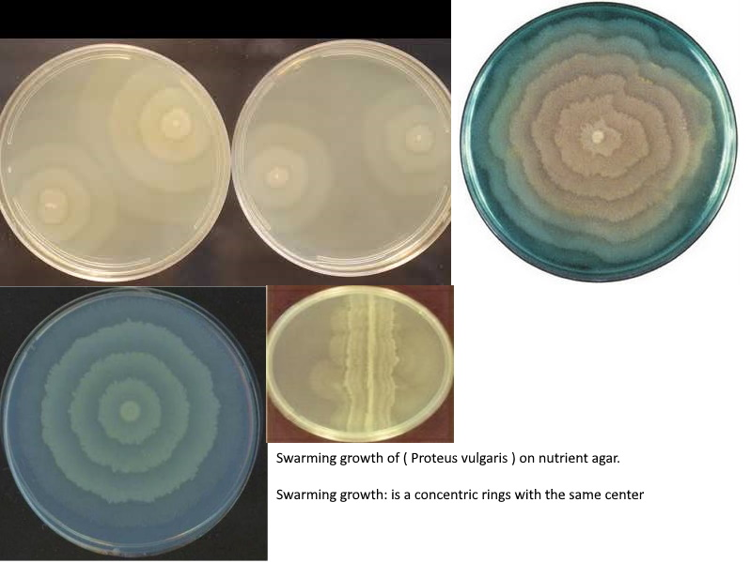

Slide 44
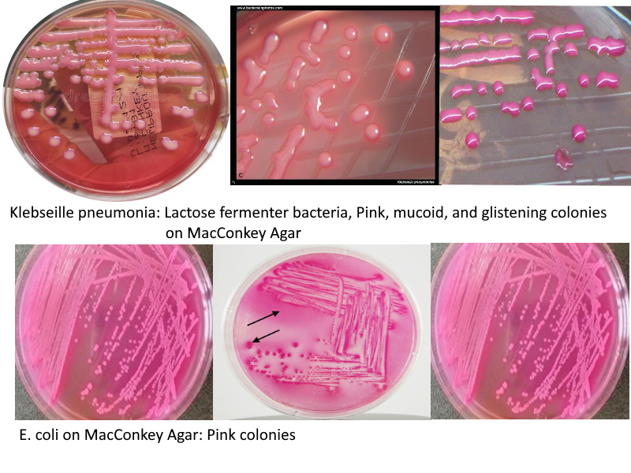
Results on MacConkey’s agar

Slide 45

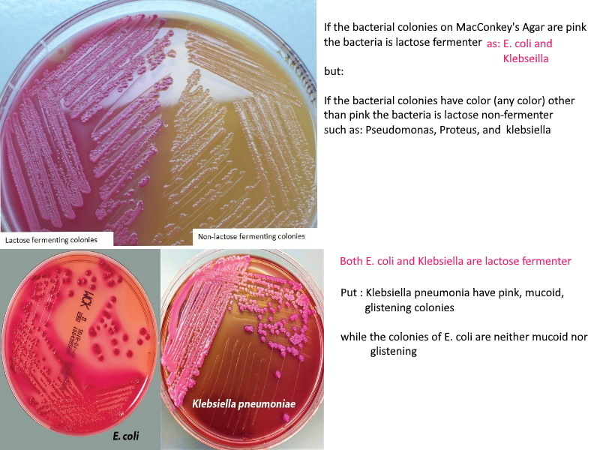

Slide 46
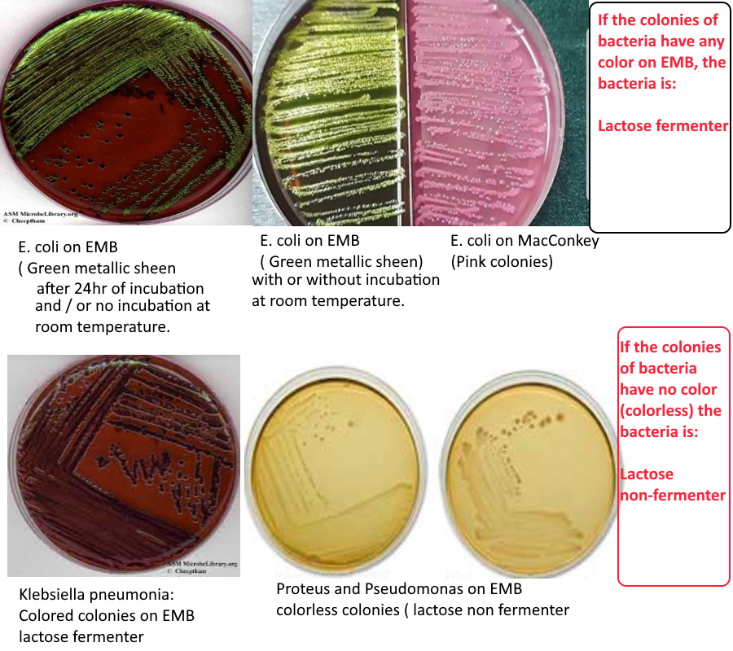
The Results on EMB

Slide 47
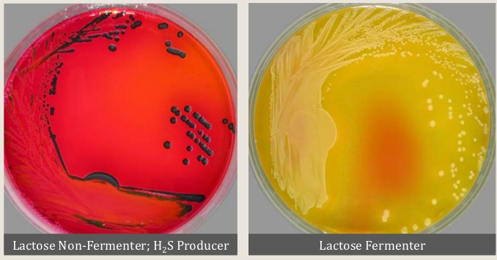
The Results on XLD (Xylose lysin deoxycholate agar)

Slide 48
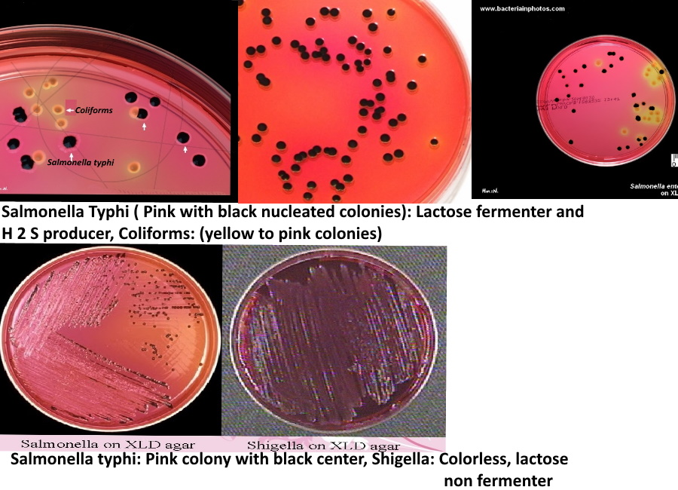

Slide 49
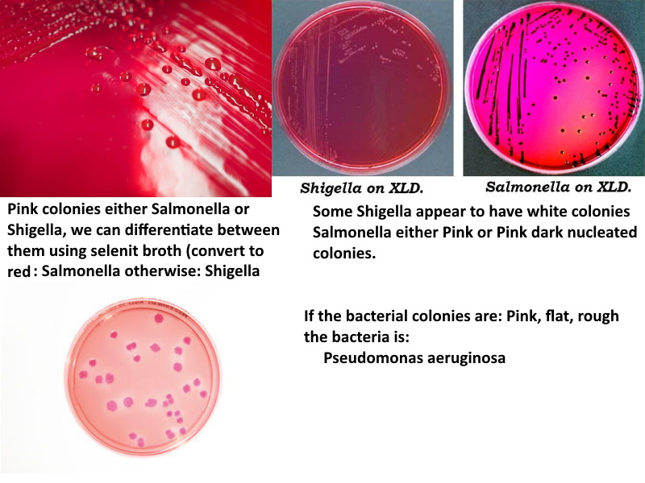

Slide 50
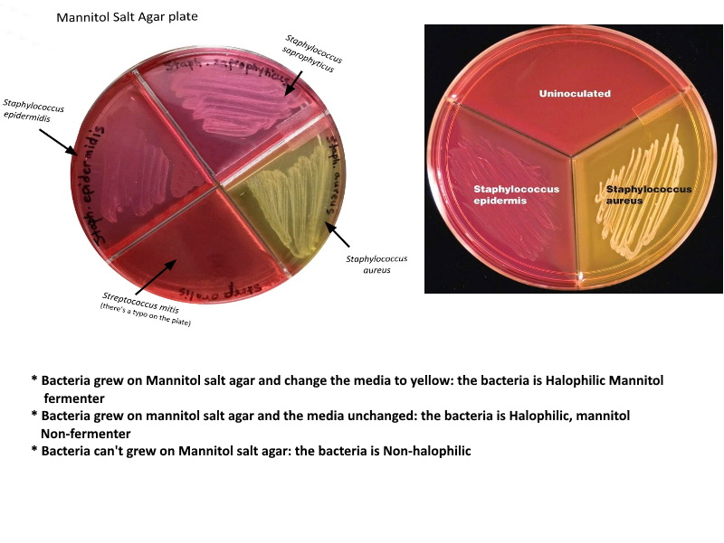
The Results on mannitol salt agar

Slide 51
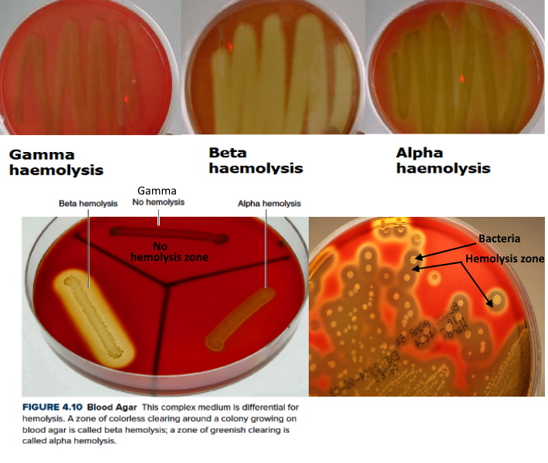
The Results on Blood Agar agar

Slide 52
The End

